Slide 1
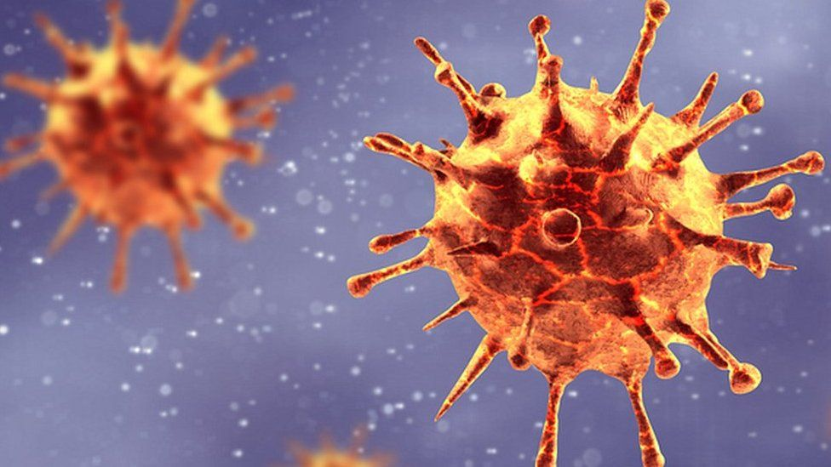
Predicting covid-19 cases in the united states
CAN VACCINATION DATA BE USED TO BUILD A MACHINE LEARNING MODEL THAT PREDICTS THE NUMBER OF DAILY NEW CASES OF COVID-19?
Notes:
Intro: Over the last 2 years, the COVID-19 pandemic has affected millions of lives in the United States and across the world. One of the main debates that arose during the pandemic is the effectiveness and legitimacy of the Covid vaccines that seemed to pop up and get approved within a short span of time. So this project will focus on the potential effect that vaccinations have on the number of new cases in the United States. We try to predict the number of new cases by building a machine learning model using vaccination data, and measure our predictions against baseline models that don’t contain vaccination data. If we can show that our model performs better using vaccination data, then we know that vaccines can be a viable solution to stopping the spread.

Slide 2
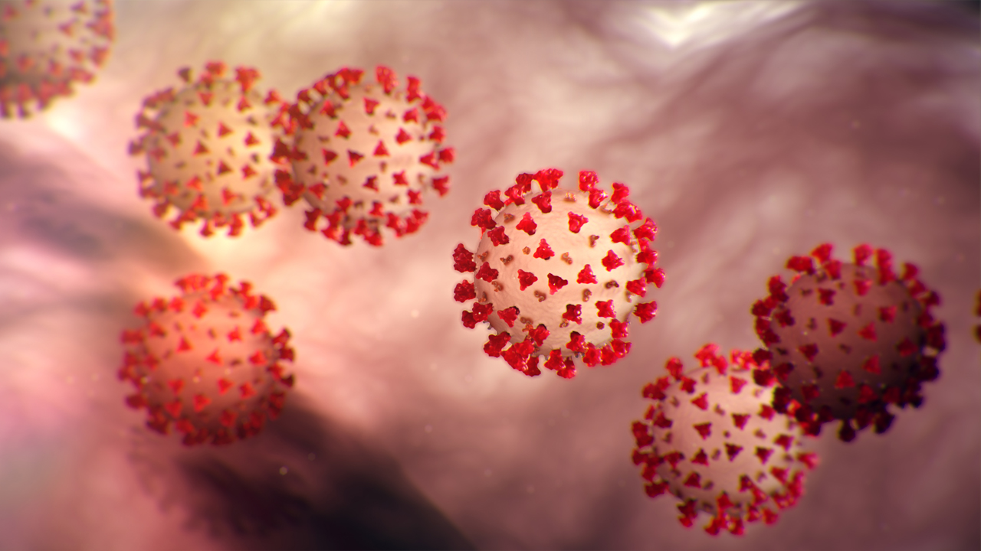
data
Notes:
Data: The first step towards building our model is collecting data. In this project, we will be using 2 datasets from Kaggle – one is a list of daily total cases per state, and the other is a list of daily total vaccinations per state.

Slide 3
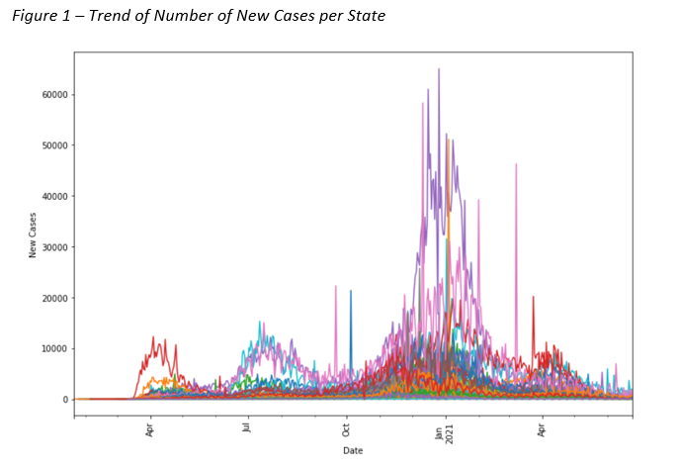
data
Notes:
Data: We take a look at the trend of daily new cases in the US over the last 1.5 years. Each color represents a different state, and even though some states have many more cases than others, there is a common trend in this graph. We see a steep incline of cases towards the end of 2020, and then a decrease at the beginning of 2021, when vaccines begin to roll out.
This increase in cases can be due to increased travel around the holiday season, or evolving lockdown restrictions and mask mandates. But even with the changing landscape, we want to build a model that can show some sort of correlation between the decrease in cases in 2021 and the increase in vaccinations.

Slide 4
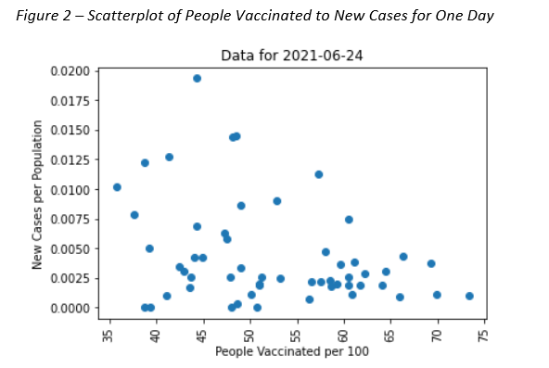
data
Notes:
Data: Here is a scatterplot of the number of people vaccinated against number of new cases for every state on a particular day. The data is normalized to the population of each state to account for the large differences in cases between populated states like New York and California, and some smaller regions like Guam and Virgin Islands.
The scatterplot is relatively random, but you can still see a slight negative correlation between the number of people vaccinated and the number of new cases, showing that vaccinations definitely have an effect on Covid cases.

Slide 5
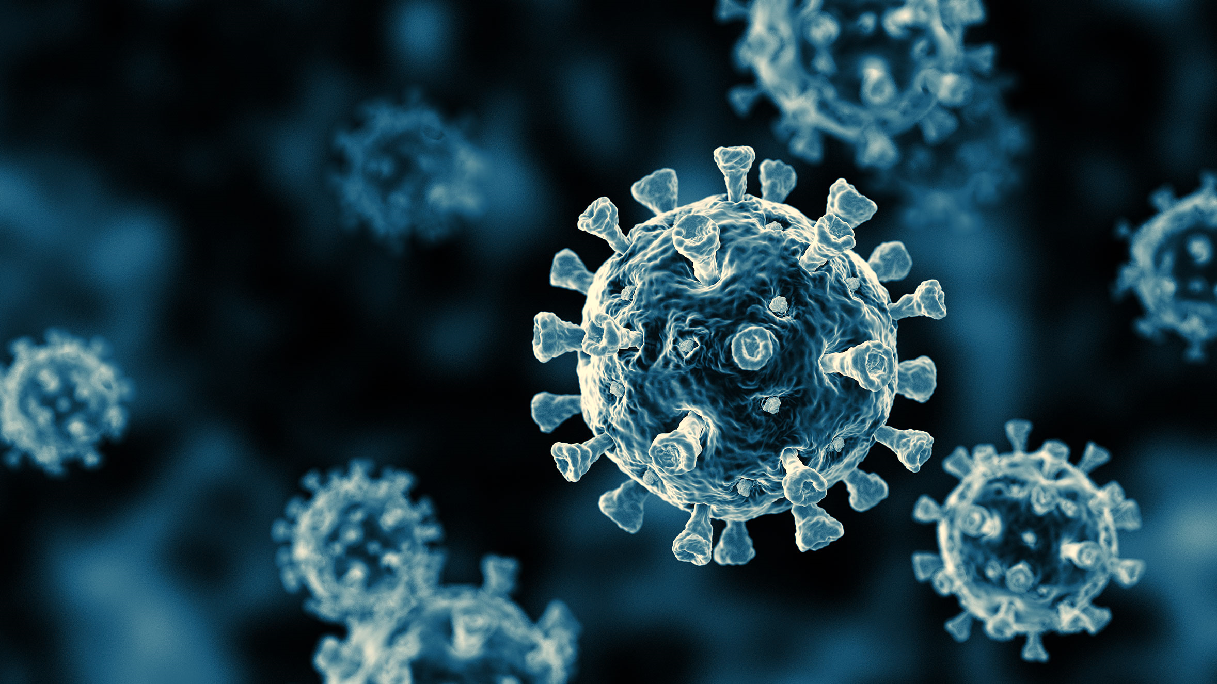
model
Notes:
Model: This project takes a multivariate time series and converts it into a supervised learning model to predict the number of new cases 7 days ahead. For our model, we are only looking at 2 columns from the dataset, the daily number of new cases per 100 people of the population, and the daily total number of people vaccinated per 100 people of the population.

Slide 6
model
NUMBER OF NEW CASES 7 DAYS BEHIND
7-DAY ROLLING AVERAGE OF NEW CASES 14 TO 7 DAYS BEHIND
3-DAY ROLLING AVERAGE OF NEW CASES 10 TO 7 DAYS BEHIND
TOTAL NUMBER OF PEOPLE VACCINATED 7 DAYS BEHIND
Notes:
Model: With some feature engineering, we build our 4 input features for the model:
Number of new cases 7 days behind
Rolling average of new cases 14 to 7 days behind
Rolling average of new cases 10 to 7 days behind
Total number of people vaccinated 7 days behind
Our goal is to use these features to predict number of new cases 7 days ahead.

Slide 7
model
KNeighborsRegressor
DecisionTreeRegressor
ExtraTreeRegressor
SVR
AdaBoostRegressor
BaggingRegressor
RandomForestRegressor
GradientBoostingRegressor
Notes:
Model: We fit our data on multiple regression models from sklearn and use each model to predict the number of new cases. We then calculate the MAE, or mean absolute error, of each model and select the one that has the lowest MAE.

Slide 8
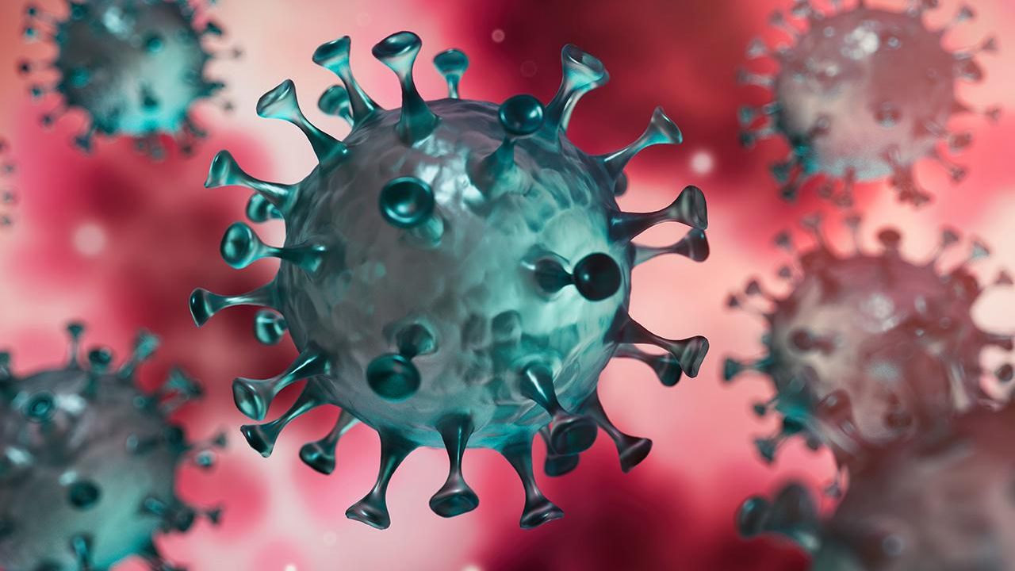
results
Notes:
Results: We found that the Gradient Boosting Regressor model resulted in the lowest MAE. We further decreased this error with some hyperparameter tuning, with our final model having a MAE of 0.003137 cases/hundred. As a frame of reference, the average new cases/hundred in our testing set is 0.00805, so the MAE is relatively high with our model – about 39%. This can be due to a number of other factors that affect COVID-19 cases that fall outside the scope of this project, including mask mandates, lockdown policies, Delta and more recent variants, etc.

Slide 9
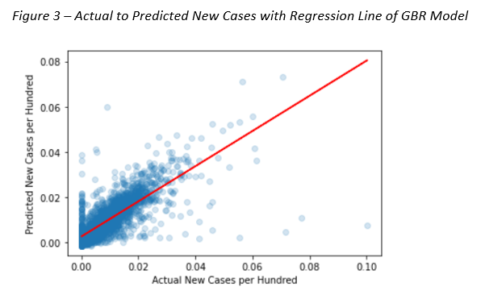
results
Notes:
Results: When we plot the actual new cases to predicted new cases from our best model, we get a positively correlated scatterplot, where the slope of the regression line is 0.78. This shows that our predicted values are pretty close to the actual numbers, with some outliers affecting the performance.

Slide 10
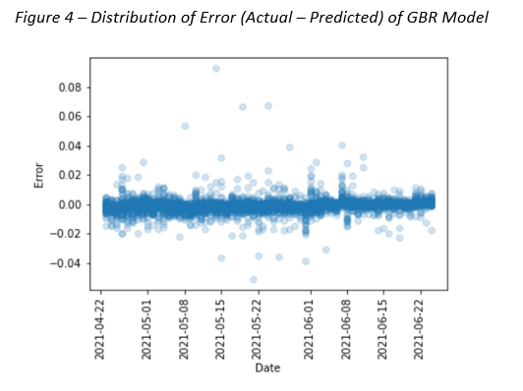
results
Notes:
Results: We also plot the distribution of the error of our model, and see that it is centered around 0, with most values between -0.005 and +0.005 cases/hundred.

Slide 11
results
BASELINE MODEL 1:
PREDICTED NUMBER OF NEW CASES =
NUMBER OF NEW CASES 7 DAYS BEHIND
ML MODEL IMPROVED ERROR BY 4.6%
Notes:
Results: As a baseline model, we assumed number of new cases at time t is equal to number of new cases at time (t-7). This baseline model resulted in a MAE of 0.003288, meaning that our best machine learning model improved the error by approximately 4.6%.

Slide 12
results
BASELINE MODEL 2:
PREDICTED NUMBER OF NEW CASES =
GRADIENT BOOSTING MODEL USING:
NUMBER OF NEW CASES 7 DAYS BEHIND
7 DAY ROLLING AVERAGE OF NEW CASES 14 TO 7 DAYS BEHIND
3 DAY ROLLING AVERAGE OF NEW CASES 10 TO 7 DAYS BEHIND
VACCINATION DATA IMPROVED ERROR BY 25.5%
Notes:
Results: If we want to isolate the effect of vaccination data on our model, we look at a second baseline model, with all the same parameters as our machine learning model except that we exclude the people_vaccinated_per_hundred feature. This model results in a MAE of 0.004211, which shows that vaccination data decreases our error by 25.5%.

Slide 13
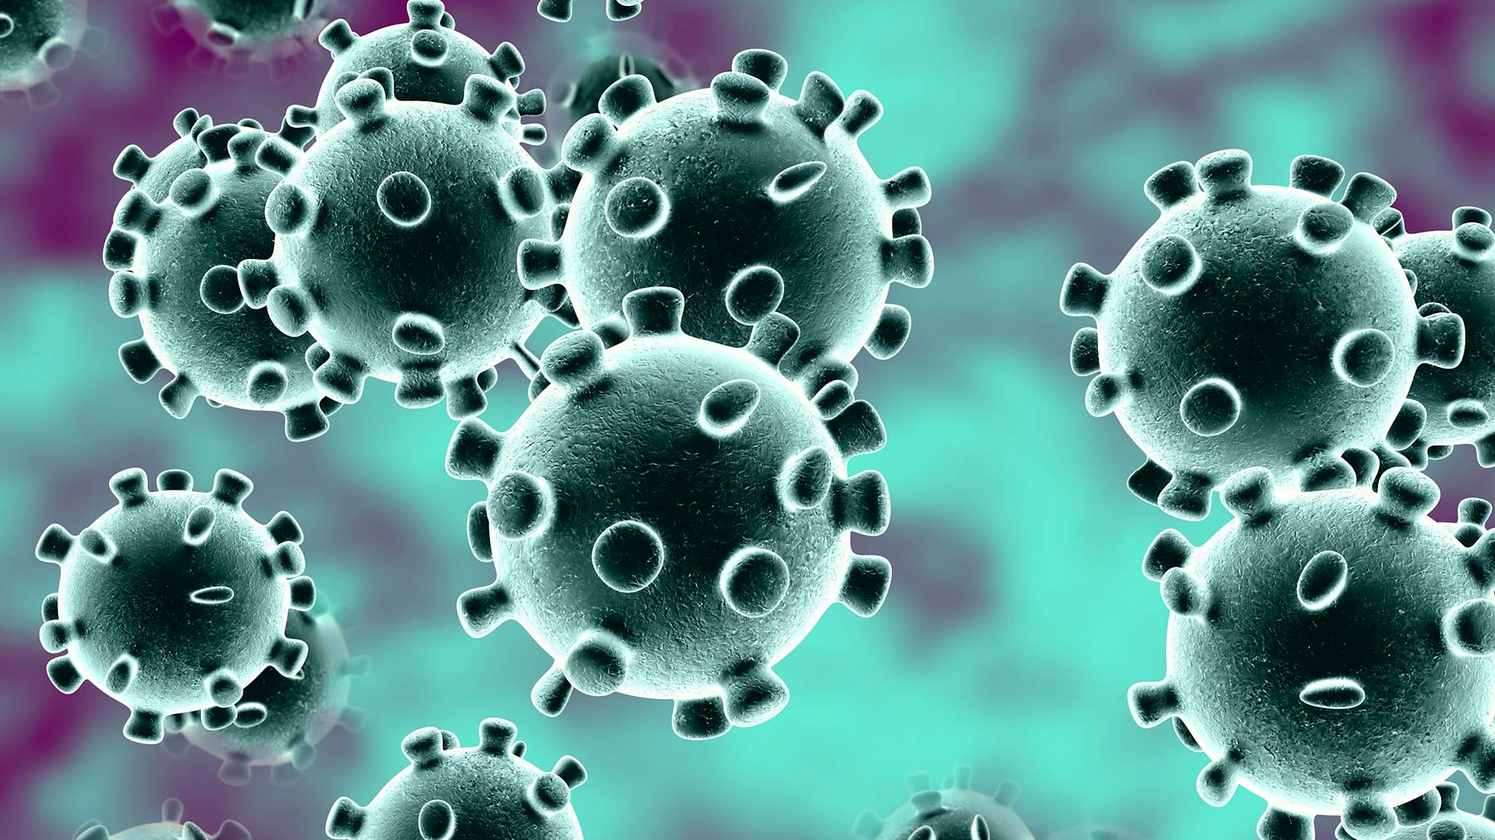
conclusion
Notes:
Conclusion: From our Gradient Boosting Regressor model, we see that there is in fact a correlation between the number of people vaccinated and the number of new cases in the United States. Comparing the two baseline models to our best performing model, we see a significant improvement when vaccination data is added. Although overall error values are high, this can be due to the various factors that determine the number of new cases that we did not account for in this project. Our findings conclude that vaccinations do have an effect on the number of Covid-19 cases in the United States.

